Slide 1

FY 2013 Public Housing and Housing Choice Voucher Family Self-Sufficiency NOFA Webcast
CFDA #14.877/14.871
Office of Public and Indian Housing
September 10, 2013

Slide 2
The Basics
Due Date: October 7, 2013, received by Grants.gov no later than 11:59:59 p.m. eastern time.
Applications must be RECEIVED and VALIDATED by Grants.gov by the deadline date and time.
The validation process may take 24-48 hours. Please allow time for this validation process to ensure that you meet the timely receipt requirements.
DUNS number and Central Contractor Registration (CCR) are still required. The CCR was converted to the System for Award Management (SAM) found at www.SAM.gov, so applicants must ensure that their registration in CCR was fully and successfully migrated to SAM.gov.
Funding Available: Approximately $18 million for PH FSS and approximately $56.8 million for HCVFSS.

Slide 3
The Basics
Please read the entire NOFA carefully to ensure all threshold and eligibility requirements are met (otherwise you will be ineligible for funding).
Please read the FY 2013 General Section carefully.
Please note that Section III.C.2 of the FY 2013 General Section was amended by the Technical Correction to the FY 2013 General Section dated October 13, 2012.
You may access the application and NOFAs on Grants.gov. A copy of the FY 2013 General Section (including the Technical Correction) may also be accessed on Grants.gov. A copy of the NOFAs may also be found on HUD’s website at: www.hud.gov/grants under “Funds Available”.

Slide 4
Major Changes at a Glance
Two nearly identical NOFAs – if you have both programs, you MUST APPLY for EACH PROGRAM SEPARATELY.
No Policy Priority Status.
No Funding Categories and Order of Funding.
If HUD receives applications for funding greater than the amount made available under this NOFA, HUD will equally prorate each award.
Notes:
Joint applicants must both be eligible entities.

Slide 5
Major Changes at a Glance
ONLY applicants funded under the HCV FSS FY2011 and/or FY2012 NOFAs are eligible to apply under this HCV FSS NOFA, and only applicants funded under the PH FSS FY2011 and/or FY2012 NOFAs are eligible to apply under this PH FSS NOFA.
PIC report is included in the NOFAs as Appendix A.
In past competitions the applicable PIC report had been posted online.
Notes:
Joint applicants must both be eligible entities.

Slide 6
Major Changes at a Glance
A sample of acceptable documentation for contesting the PIC report is included as Appendix B.
New definitions
Definitions for cap on number of positions, job-sharing, number of coordinators supported by PIC, and program coordinating committee were added to both NOFAs.
Notes:
Joint applicants must both be eligible entities.

Slide 7
Major Changes at a Glance
Clarification on treatment of transfers and consolidations, and joint applicants.
Fewer forms
Streamlined Logic Model and improved functionality
Notes:
Joint applicants must both be eligible entities.

Slide 8
Target Period
The target period (the period used by HUD to determine the number of FSS participants in PIC and other relevant information) under the NOFAs is April 1, 2012-March 31, 2013.
Notes:
Joint applicants must both be eligible entities.

Slide 9
PIC Report (Appendix A)
Appendix A of the NOFAs include a PIC report showing the PHA’s total number of FSS participants in PIC.
The PIC report also shows new data:
The number of FSS coordinators supported by PIC,
The cap on number of positions: the most recent number of FSS program coordinator positions funded (in FY 2011 or FY 2012, as applicable), and
The most recent award amount (FY 2012 or FY 2011, as applicable).
Notes:
Joint applicants must both be eligible entities.

Slide 10
PIC Report (Appendix A)
The PIC report no longer shows:
Number of FSS participants with a progress report,
Number of FSS participants with a progress report and escrow,
Number of FSS participants who successfully completed the program.
These data points are no longer relevant under the NOFAs because there are no funding categories and priority for PHA’s with the highest percentage of families with positive escrow balances (as in the FY 2012 HCV FSS NOFA), or with the highest percentage of families with increased earned income (as in the FY 2012 PH FSS NOFA).
Notes:
Joint applicants must both be eligible entities.

Slide 11
PIC Report (Appendix A)
ONLY include documentation correcting the number of FSS participants in Appendix A if:
You are requesting more positions than the number of FSS coordinators supported by PIC (as listed in the PIC report) and your position cap is higher than the number of FSS coordinators supported by PIC, or
Your data is missing from the PIC report.
Do not submit documentation if the number of FSS coordinators supported by PIC is greater than or equal to the number of FSS coordinators that you are applying for.
For example, if your PHA’s application is requesting 1 full-time position and HUD’s PIC report shows 1 full-time position supported by PIC (with 26 FSS program participants), do not submit documentation showing that your PHA actually has 37 FSS program participants.
Notes:
Joint applicants must both be eligible entities.

Slide 12
PIC Report (Appendix A)
Do not submit documentation if the cap on number of positions (as listed in the PIC report) is less than or equal to the number of FSS coordinators supported by PIC (as listed in the PIC report).
For example, if your PHA’s cap on the number of positions is 2 full-time positions and HUD’s PIC report shows 2 full-time positions supported by PIC, do not submit documentation showing that your PHA actually has enough families to support 3 full-time positions.
Notes:
Joint applicants must both be eligible entities.

Slide 13
Example 1
In this example, this PHA must submit documentation showing that they have at least 15 FSS participants in the target period to be funded. The PHA will not be funded for more than 1 part-time position.
PHA | Total Number of FSS Participants | Number of FSS Coordinators Supported by PIC | Cap on Number of Positions
Anytown PHA | 11 | 0 | .5

Slide 14
Example 2
In this example, this PHA would not submit documentation even if they can show that they have 75 FSS participants during the target period (which supports 2 FSS coordinators), because PIC already supports their Cap of 1 full-time FSS coordinator.
PHA | Total Number of FSS Participants | Number of FSS Coordinators Supported by PIC | Cap on Number of Positions
OtherTown PHA | 65 | 1 | 1

Slide 15
Eligible Applicants
ONLY applicants funded under the HCV FSS FY2011 and/or FY2012 NOFAs are eligible to apply under this HCV FSS NOFA, and only applicants funded under the PH FSS FY2011 and/or FY2012 NOFAs are eligible to apply under this PH FSS NOFA.
Funding under the NOFAs will be based on the most recent award amount.
Notes:
Joint applicants must both be eligible entities.

Slide 16
Eligible Applicants
Eligible applicants may apply for NO MORE THAN:
The Cap on Number of Positions: the number of Coordinators they were most recently awarded (in FY 2011 or FY 2012, as applicable), and
The Dollar Amount they were most recently awarded (in FY 2011 or FY 2012, as applicable).
Notes:
Joint applicants must both be eligible entities.

Slide 17
Eligible Applicants - Example
If PHA A was awarded funding for 2 HCV FSS coordinators in FY 2012 for a total funding amount of $138,000, PHA A will be eligible to apply under this HCV FSS NOFA for only up to 2 HCV FSS coordinators and for no more than $138,000.
Notes:
Joint applicants must both be eligible entities.

Slide 18
Number of Families Served
Eligibility will still be based on the number of FSS program participants in the applicant’s FSS program during the target period.
The formula also remains the same:
15-24 families qualifies applicant for 1 part-time renewal position.
Minimum of 25 families qualifies applicant for 1 full-time renewal position.
50 families more than the previous level qualifies applicant for renewal of more than 1 full-time position.
For example: 75 families qualifies applicant for 2 full-time renewal positions, 125 families qualifies applicant for 3 full-time renewal positions, and so on in increments of 50.

Slide 19
Number of Families Served
The chart below provides a visual representation of the formula.
Number of FSS families served during the target period | Number of renewal positions supported
15-24 families | 1 part-time position
25-74 families | 1 full-time position
75-124 families | 2 full-time positions
125-174 families | 3 full-time positions
175-224 families | 4 full-time positions
225-274 families | 5 full-time positions
275-324 families | 6 full-time positions
325-374 families | 7 full-time positions
375-424 families | 8 full-time positions
And so on in increments of 50

Slide 20
Number of Families Served
Exception (for PH FSS programs only): if you were first funded under the PH FSS NOFA in FY 2012, you do not have to meet the minimum number of FSS participants to be renewed THIS YEAR.
See Appendix C of the PH FSS NOFA for a list of applicants to which this exception applies.

Slide 21
Joint Applicants
Eligible applicants who previously applied jointly under the FY 2011 and/or the FY 2012 NOFAs may not apply separately, and may not add new joint applicants under this year’s NOFAs.
However, the composition of the joint applicants may change to remove any member(s) or change a co-applicant to a lead applicant (or vice-versa).
See the NOFAs for more details and examples.

Slide 22
Transfers/Consolidations
A receiving PHA under a program transfer or consolidation will qualify for the combined number of positions supported by the receiving and divesting PHAs’ number of HCV or PH FSS program participants (as applicable) served during the target period, subject to the combined cap on number of positions of the receiving and divesting PHAs.

Slide 23
Transfers/Consolidations
The award amount for a receiving PHA under a program transfer or consolidation may not exceed the combined most recent award amount (FY 2011 or FY 2012) of the receiving and divesting PHAs.
See the NOFAs for examples.

Slide 24
Capacity to Administer/Past Performance Review
The Field Office (FO) will review the following:
The PHA’s PHAS (for PH FSS) and SEMAP (for HCV FSS) designation, any PHAS/SEMAP deficiencies, any progress towards recovery,
Other HUD management review; Outstanding Delinquent Federal Debts; and/or audit findings (e.g. IPA Audits and/or IG Audits) affecting the FSS program, and
Findings concerning reporting on financial (SF-425 for PH FSS, VMS for HCV FSS) and tenant data (PIC) and/or logic model reporting.

Slide 25
Capacity to Administer/Past Performance Review
Applicants found by the FO to have capacity or past performance challenges that call into question the ability of the PHA to properly administer an effective HCV or PH FSS program may be placed on high risk (per 24 CFR 85.12) and required, at time of award, to enter into a remediation agreement with the HUD field office.
A Remediation Agreement may include contracting with an entity acceptable to the HUD field office to act as Contract Administrator for the program.

Slide 26
Capacity to Administer/Past Performance Review
If the FO determines that a remediation agreement is necessary, the FO will notify the PHA prior to award that a Remediation Agreement/Contract Administrator is needed and will work with the PHA to put the plan in place prior to the funds being made available.
If a Remediation Agreement is required, funding will be contingent upon execution of the agreement.

Slide 27
Capacity to Administer/Past Performance Review
The PHA will also be informed of the requirement of a Remediation Agreement/Contract Administrator in their Award Letter.
For PH FSS, the Remediation Agreement/Contract Administrator will be worked out between the FO and the awardee after award is obligated, but before funds are released.

Slide 28
Capacity to Administer/Past Performance Review
For HCV FSS, the Financial Management Center will be given a list of which PHAs require a Remediation Agreement/Contract Administrator and will hold those obligations until the FO informs HQ that the requirement has been met.

Slide 29
Eligible Activities
Annual salary and fringe benefits for FSS program staff.
Funding may also be used to continue to employ FSS coordinator support positions funded under previous FSS NOFAs that made funding available for such FSS positions.

Slide 30
Eligible Activities
A part-time FSS program coordinator may be retained where appropriate.
The funds for a FSS coordinator position may be used to job-share with more than one employee if FSS functions are shared.
If job-sharing, the funds may be pro-rated to more than one staff member.

Slide 31
Ineligible Activities
Funds under the HCV FSS NOFA may not be used to pay the salary of a PH FSS coordinator for a PH FSS program, and funds under the PH FSS NOFA may not be used to pay the salary of an HCV FSS coordinator for a HCV FSS program.
An HCV FSS program coordinator may only serve HCV families while the PH FSS program coordinator may only serve public housing residents.
Exception: PHAs that are converting public housing units to project-based voucher (PBV) or Project Based Rental Assistance through the Rental Assistance Demonstration (RAD) will be allowed to use any PH FSS funds granted previously or pursuant to the FY 2013 PH FSS NOFA, to serve those FSS participants who live in units converted by RAD. (See RAD Notice for more information.)

Slide 32
Ineligible Activities
Payment of services for FSS program participants or administrative activities.
Performance of routine HCV or PH program functions.
However, an FSS program coordinator may perform some program functions, such as annual reexaminations for FSS participants, if it enhances the effectiveness of the FSS program.

Slide 33
Ineligible Activities
Compensation of coordinators for homeownership functions performed for families not enrolled in the FSS program.
Paying for a contract administrator or grant writer.

Slide 34
Program Requirements
FSS programs must be administered in accordance with HUD regulations and requirements in 24 CFR part 984, and must comply with other HCV or PH program requirements, notices, and guidebooks.
FSS requirements include using a Program Coordinating Committee to secure the necessary resources to implement the FSS program.
The PCC may be shared between PH FSS, HCV FSS and ROSS-SC programs, if it meets all of the program’s needs.
See 24 CFR 984.202 for more information.

Slide 35
Program Requirements
Participating families must enter into a contract of participation. The contract must be completed no later than 5 years after its effective date (unless granted an extension of up to 2 more years by the PHA).
Loss of funding for the FSS coordinator position does not relieve the PHA of its contractual obligation to families already under FSS contract.

Slide 36
Program Requirements
Affirmatively Furthering Fair Housing
NOFA identifies actions that must be taken by successful applicants. Be sure to document compliance in your program records/files.
Policy Priorities
NOFA identifies actions that grantees must adhere to. Be sure to document compliance in your program records/files.
HUD may request documentation of meetings held or partnerships/MOUs established along with annual reporting.

Slide 37
Program Requirements
Salary Comparables
For all positions requested under this NOFA, evidence of salary comparability to similar positions in the local jurisdiction must be kept on file in the PHA office.
Conducting Business in Accordance with Core Values and Ethical Standards
Because all eligible applicants were funded in FY 2011 and/or FY 2012 and required to have a Code of Conduct during those NOFA competitions, applicants are not required to submit a Code of Conduct when applying to this NOFA.

Slide 38
Program Requirements
Other requirements include, among others, compliance with fair housing and civil rights laws, ensuring that notices of and communications during all training sessions and meetings are provided in a manner that is effective for persons with hearing, visual, and other communications-related disabilities.
See the NOFAs for more details.

Slide 39
Program Requirements - Section 3
Section 3 requirements are applicable to the PH FSS program.
These requirements apply to the hiring of PH FSS Coordinators.
There are separate reporting requirements which include an annual HUD-60002 paper or online submission.
Section 3 is getting serious about this and may in the future impose penalties for non-reporting that may include ineligibility for future funding.
Do not send reporting with your FSS application.

Slide 40
Program Requirements - Section 3
While Section 3 is not applicable to the HCV FSS program grantees are encouraged to:
Make low- and very low-income participants aware of training and employment opportunities created as a result of the funds awarded under this NOFA.
When new HCV FSS program coordinators are hired, PHAs are encouraged to target low- and very low-income residents of the PHA and other low- and very low-income residents of the metropolitan area for new positions.

Slide 41
Funding Limits
Funding limits remain the same:
Up to $69,000 in salary and fringe benefits for each full-time coordinator position, and
Up to $34,500 in salary and fringe benefits for each part-time position.
Remember to have salary comparables on file.
THERE WILL BE NO SALARY INCREASES IN FY 2013.
Notes:
For audit purposes, applicants must have documentation on file demonstrating that the salary and fringe benefits of the project coordinator are comparable to similar professions in their local area.

Slide 42
General Section Threshold Requirements
There are 10 General Section Threshold Requirements.
3 of the 10 requirements are considered met:
Consistency with the consolidated plan
Financial system that meets federal requirements
Name check review.

Slide 43
General Section Threshold Requirements
A DUNS Number is required.
Your CCR/SAM must be current (registration is good for only one year).
Please be sure to read the General Section and Technical Correction carefully.

Slide 44
Fewer Forms
No HUD-2991 “Certification of Consistency with the Consolidated Plan” or HUD-52752 “Certification of Consistency with the Indian Plan” required.
Code of Conduct requirement waived because all eligible applicants were funded in FY 2011 and/or FY 2012 and required to have a Code of Conduct during those NOFA competitions.
No contract administrator partnership agreement (if FO requires it as a result of the capacity/past performance review, as described in slides 23-26 above) required at the time of application, but funding will be contingent upon its execution.

Slide 45
Application Forms
Form SF-424 – Application for Federal Assistance – Required
SF-LLL – Disclosure of Lobbying Activities - If applicable
HUD-52651 – FSS Application Form –Required
HUD-2880 – HUD Applicant/Recipient Disclosure Report – Required
HUD-2993 – If applicable (only for those who request a waiver to submit a paper application)
HUD-96011 – Facsimile coversheet – Required even if you don’t submit faxes.
HUD-96010 – This is the Logic Model – Required

Slide 46
Application Forms
Forms are found on the Application Download and on the Instructions Download.
Note: make sure to download both the application package and the application instructions to ensure that you complete all required forms.

Slide 47
Application Forms
Application Download contains:
Mandatory Forms:
1) SF-424
2)HUD-2880
3)HUD-96011: use this when faxing in documents to your application.
Optional Forms:
1) SF-LLL
2) Attachments Form: use this when attaching documents to your application.

Slide 48
Application Forms
Instructions Download contains:
HUD-52651
HUD-2993
HUD-96010 (Logic Model)
A copy of the General Section and Technical Correction
A copy of the program NOFA.

Slide 49
Form SF-424
SF-424 – DO THIS FIRST – it will fill in sections of other forms automatically
Question 2 “Type of Application”– select the continuation box.
Question 5a “Federal Identifier” = PHA code.
Question 5b “Federal Award Identifier”– enter “0000”
Questions 10, 11, 12 and 13 are pre-populated. Don’t change them!

Slide 50
Form SF-424
Question 15 “Descriptive Title of Applicant’s Project” - Suggest using name of your PHA plus program name. For example: “AnytownHA_PHFSS”.
Question 16 “Congressional District of Applicant…” - if the location of the applicant’s office and the location of the program/project is within the same Congressional District, you should include the same answer for both parts.

Slide 51
Form SF-424
Question 17 “Project proposed start and end date”
For PH FSS - Estimate it - Jan 1 2014-Dec 31 2015 is fine, or, you may use the end date of your last grant as the start date.
For HCV FSS - All applicants should enter the effective date of January 1, 2014 and expiration date of December 31, 2014.

Slide 52
Form SF-424
Question 18 – Estimated Funding –
18a is THE AMOUNT YOU ARE REQUESTING. Include the dollar amount for fringe benefits, if applicable
Do not enter any amounts on other parts of this question. The total will be prepopulated with your answer to Question 18a.

Slide 53
Form SF-424
Question 19 - answer c. Program is not covered by E.O. 12372.
Do not add attachments to the SF_424. Use the Attachments Form in the electronic application to submit attachments and/or fax attachments.

Slide 54
Form SF-LLL
SF-LLL – Disclosure of Lobbying Activities (if applicable)
SF-LLL-A – Disclosure of Lobbying Activities Continuation Sheet (if applicable)
It can be downloaded from HUDCLIPS.
IF THIS FORM IS NOT APPLICABLE, DO NOT SEND IT IN WITH YOUR APPLICATION.
Notes:
If you have or intend to conduct lobbying activities using federal funds, you have to use this form.

Slide 55
Form HUD-2880
HUD-2880 – Applicant/Recipient Disclosure/Update Report
Responses to the threshold questions under Part I of the form determines whether the rest of the form must be completed.

Slide 56
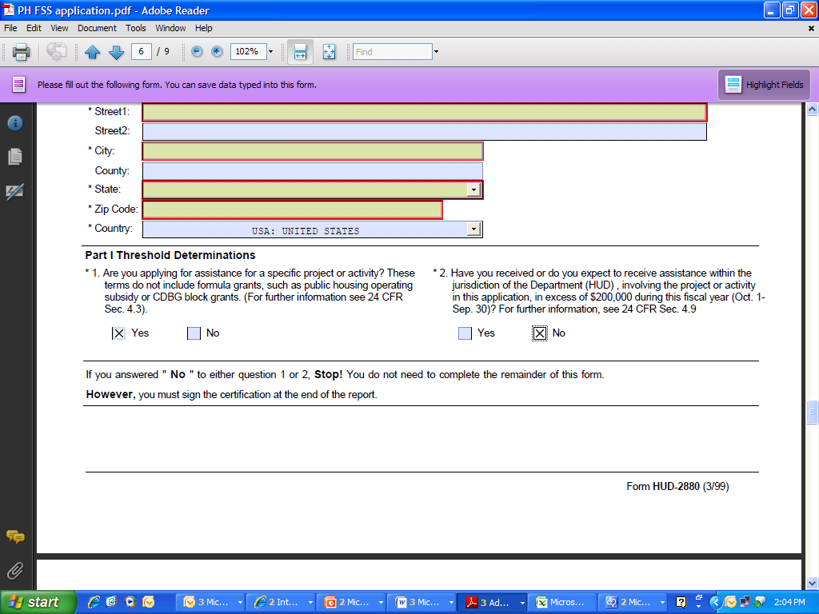
Form HUD-2880
How to answer the threshold questions:
Answer to question 1 is YES
Answer to question 2 applies only to THIS grant application. Should only be YES if you are requesting more than $200,000 for THIS grant
ONLY IF YOU ANSWER YES TO BOTH QUESTIONS YOU MUST FILL OUT PARTS II OR III.

Slide 57
Form HUD-96011
HUD-96011 Facsimile Transmittal
Required of all applicants even if not transmitting any faxes (if no faxes, indicate “no faxes with this submission” and “1” for number of pages).
FAX NUMBERS (same as 2012)
1-800-HUD-1010 – toll free
215-825-8798 - non-toll free.

Slide 58
Additional Note on Faxes
Use HUD-96011 as the cover sheet if you submit any fax attachments or they will NOT be attached to your application.
Entire applications submitted by fax will NOT be accepted.
Use a separate HUD-96011 cover sheet for each document and fax separately.
Notes:
Check accuracy of faxes

Slide 59
Additional Note on Faxes
Make sure you use the fax cover sheet from the same application package that you submit (especially important if you download more than once).
If the unique identifier on the Facsimile Transmittal form covering documents faxed in support of your application does not match the unique identifier in your application, HUD will not be able to match the faxes received to your application submission.
Notes:
Check accuracy of faxes

Slide 60
Additional Note on Faxes
If you re-submit electronically, you must wait for validation, then re-fax all faxes!
See the General Section for more details.
Notes:
Check accuracy of faxes

Slide 61
Form HUD-52651 –FSS Application Form
All applicants must complete Part I, Part II.A and Part II.C.
Leave Part II.B and Part III blank, as these sections are not applicable under this competition.

Slide 62
Form HUD-52651 –FSS Application Form
Enter 0.5 in Part II.A “Previously Funded Positions” and Part II.C.1 “Total Requested” if:
Your cap is 1 part-time position, and/or
You are requesting 1 part-time position.
Part II.C – totals for Part II.A. (as mentioned above, Part II.B is not applicable under these NOFAs).

Slide 63
Form 96010
HUD 96010 - Logic Model
DO NOT make into a PDF
The PH and HCV FSS logic model forms look exactly the same, but they’re not. They have a different CFDA number on them, so DO NOT submit the same one for both programs.
If applying for both programs you must download and complete separate logic model forms for each program.

Slide 64
Changes to the Logic Model
There are 9 tabs on the Logic Model (LM):
Instructions (really, read this!)
Coversheet
Worksheet (no more Year 1, 2, 3, Final)
Reporting (not used in application)
The other tabs are lists of the drop-downs
Goals/Priorities
Needs
Services
Outcomes
Tools

Slide 65
Changes to the Logic Model
READ THE INSTRUCTIONS TAB CAREFULLY.
Always start entering your information with the Coversheet Tab.
Only the Coversheet, Worksheet, and Reporting Tabs are used to enter information.
All other tabs are reference tabs.

Slide 66
Changes to the Logic Model
No more drop-downs/choices – the following columns on the Worksheet Tab are pre-filled and are the same for both FSS programs.
HUD Goals/Policy Priorities
Needs
Services/Activities
Outcomes

Slide 67
Changes to the Logic Model
“Pre” is now called “Projection”.
“Post” is now called “Annual” (or “extension”).
There is no longer “YTD”.
You must provide a projection for every Activity/Output and every Outcome listed, even if that projection is ZERO.
You must use the drop-downs to fill in the required fields in Column 7 “Evaluation Tools/Accountability”.

Slide 68
Changes to the Logic Model
All Activities/Outputs and Outcomes are “locked” and cannot be changed.
HOWEVER, all “projection”, “annual” and “extension” fields are unlocked.
This is so that there is no longer any “locking/unlocking” required for reporting.
FOR APPLICATION, FILL IN ONLY THE “PROJECTION” column.
The “Annual” and Extension” columns are ONLY used when reporting. DO NOT fill them in at the time of application.
Please note that the “Extension” column is to be used ONLY if given an extension by HUD.

Slide 69
Changes to the Logic Model
Your Field Office will review the LM with you at the time of award before they send it to the initial data base to have the projections aggregated.
No policy priorities to be chosen in the activities/outcomes.
No policy priority status.
Number of Management Questions has been reduced.

Slide 70
Changes to the Logic Model
If you have questions on LM format/function, please call the Office of Strategic Planning and Management at the number listed in the instructions tab on the LM.

Slide 71
Reporting
Logic Model reporting is ANNUAL
Reports are due 30 days after your funding expiration or end date.
You must respond to all Management Questions on the Reporting Tab.
For the PH FSS program, annual reporting also includes the Federal Financial Report – SF-425.

Slide 72
Reporting
Reporting also includes entering information on the FSS addendum on form HUD-50058.
Enrollment and exit reports are completed at the beginning and end of the family’s participation in FSS.
A progress report must be completed at least annually during each family’s participation in the program.
See PIH Notice 2011-65 for more details on FSS PIC reporting requirements.
TAKE THIS SERIOUSLY.

Slide 73
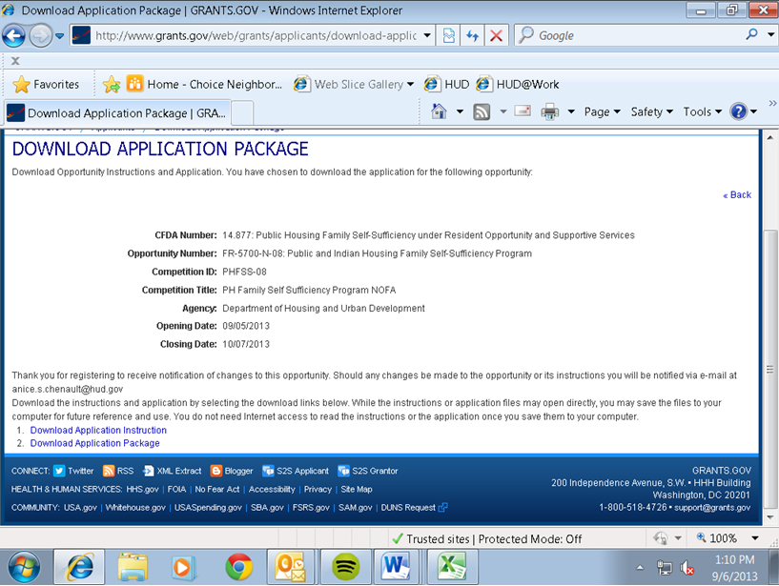
Putting Your Application Together: Grants.gov

Slide 74
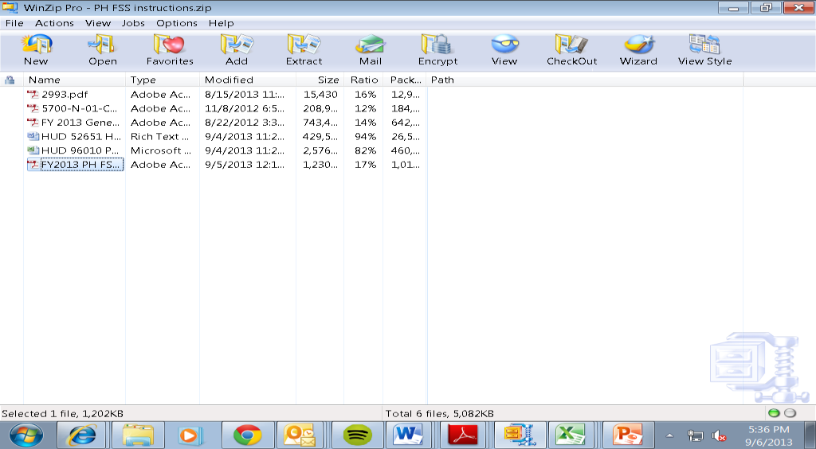
Instructions Download

Slide 75
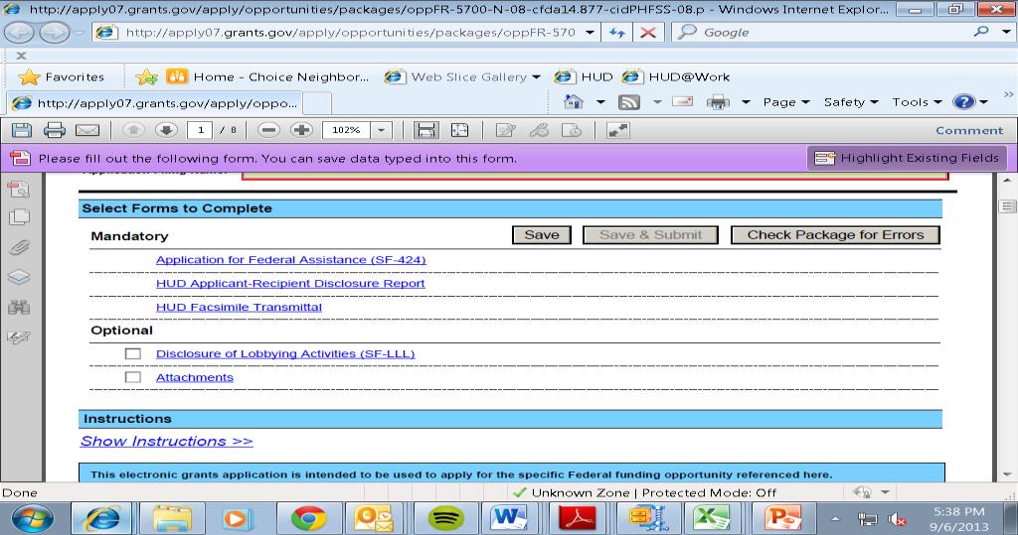
How to Use Application Package
Notes:
To open a form, move it from the left box to the right box. It will open below the main application – SCROLL DOWN. If you have moved a form to the right, the system will assume you want to submit it and will not let you until you fill in all of the mandatory (yellow) fields. If you do not want to submit it, move it back to the left. If a form is optional in the NOFA and does not apply to you (e.g. SF LLL) DO NOT SUBMIT IT.

Slide 76
Registration Process
If your Authorized Representative has left, follow the registration steps below to have a new one registered and authorized to submit the application.
Register a user name and password (Authorized Organization Representative [AOR] ID) at Grants.gov;
The applicant organization’s E-Business Point of Contact (E-Biz POC) logs in to Grants.gov to grant authority to the Authorized Organization Representative (AOR);
The AOR confirms his or her status as ―authorized applicant‖ to submit an application on behalf of the organization.
Incomplete registration was the most common error and resulted in applicants not receiving funding.

Slide 77
Registration Process
If you changed your eBusiness Point of Contact, in the CCR/SAM Registration, make sure that the new eBusiness Point of Contact has also granted permission to the person submitting the application to be the Authorized Organizational Representative (AOR).
Registration checklist and other information at www.grants.gov/GetStarted.

Slide 78
Renewal/Update Registration Process for CCR/SAM POCs
You must renew your CCR/SAM Registration annually.
Registrations in CCR/SAM are active for one year.
The CCR/SAM registrant is notified by email one month prior to the registration expiration date that the CCR/SAM registration will be expiring.

Slide 79
Renewal/Update Registration Process for CCR/SAM POCs
The email provides instructions for how to update/renew the CCR/SAM registration.
Please read the General Section for more information.
You can also go to: www.sam.gov

Slide 80
Application Submission
Grants.gov recommends using Internet Explorer to submit applications.
The Application download contains the Adobe forms created by Grants.gov which are compatible with Microsoft Windows Vista operating system, Apple Macintosh computers, and Microsoft Office 2007.

Slide 81
Application Submission
See General Section for information on downloading the latest version of Adobe Reader.
Before you can view and complete the application you MUST have a compatible Adobe Reader installed.

Slide 82
Application Submission
The two forms in the Instructions Download that everyone will need are a WORD form (HUD 52651) and an EXCEL form (HUD 96010).
These are both fillable and saveable. You may save and attach as WORD and EXCEL files. Do not make them PDFs. You may fax with the cover sheet if you prefer.
One form is a PDF (HUD 2993). It is not fillable. However, it’s only if you submit a paper application. No waivers for paper applications were granted last year, so we do not anticipate anyone will need to use this form.

Slide 83
Application Submission
DO NOT download the application and save to or attempt to upload from a USB flash drive. Applicants have had difficulty with this in the past. Save and upload from your hard-drive.
If more than one person is working on the application package, all must be using the same software version.
Notes:
Notes on attaching – please make sure you attach the version you are intending to
Follow the tips provided—
Save the final files in a folder on your desk top;
open each file;
After attaching the files open them again and make sure they are complete.
many applicants last year submitted older versions of their files. Not the last version. Don’t just scroll through the first part of the file, but open them and read the app them before hitting the submit button.

Slide 84
Application Submission
In order to reduce the size of attachments, you can compress several files using a ZIP utility.
Files compressed with the WinZip utility must use WinZip 14 or earlier versions and must be zipped using either the ―Normal option or ―Maximum (portable) option available to ensure that HUD is able to open the file.
See the General Section for more information on rules to follow when creating attachments.

Slide 85
Application Submission – File Names
File Names with more than 50 characters (HUD recommends 32), special characters, or spaces will result in a rejection for a “VirusDetect” error.
Failure to follow attachment naming requirements may result in rejected applications. THIS HAS HAPPENED!
Please use the logic model naming conventions in the Logic Model instructions .

Slide 86
Application Hints
If you choose to attach saved files, please, after you save them, open them back up again to see if what you entered is really saved.
If you have just the free version of Acrobat READER, you WILL NOT BE ABLE TO SAVE… you will probably just be saving a blank form.

Slide 87
Application Hints
The General Section also has LOTS of information on registering.
Register for updates with grants.gov
You will be given the option when you go to download the application/instructions.
Notes:
Some forms are in “mandatory documents” some are in “optional documents” BOTH of those are pure-edge.
Other forms are in “instructions download”
All forms you need should be in that package.

Slide 88
Once You’ve Submitted Your Application…
Upon successful submission, applicants will receive an e-mail notification confirming receipt and indicating that the application is being validated.
The validation process will be completed in approximately 24 to 48 hours.

Slide 89
Once You’ve Submitted Your Application…
You will then get a validation email.
REMEMBER: If you re-submit electronically, you must re-submit your faxes, and the last validated submission received in accordance with timely receipt requirements will be reviewed.

Slide 90
Once You’ve Submitted Your Application…
If the application does not pass the validation check, it will be rejected and the applicant notified of the reason for the rejected application.
DO NOT ASSUME that the application has been successfully submitted until you receive the validation notice.

Slide 91
Once You’ve Submitted Your Application…
If a rejection notice is received, you must correct the error and resubmit.
If you successfully uploaded your application within the application deadline but subsequently receive a rejection notice, you will have a 24 hour “grace period” beyond the deadline date to re-submit.

Slide 92
Application Status
You can check on grants.gov to see the status of your application.
HUD has received the application you submitted when it says “Your application has been reviewed by the Grantor agency and assigned an Agency Tracking Number.” That means it’s been received and validated. There’s nothing else that Grants.gov can tell you after this.

Slide 93
Application Status - Hints
If there is a problem with your application submission, an email will be sent to the person designated in your REGISTRATION, not in your APPLICATION because we will not have been able to read your application yet.
Make sure that the person designated in your REGISTRATION is checking his/her email in anticipation of a validation email.

Slide 94
Other Hints
Make sure that someone will be available to cure deficiencies, both at time of application submission and during the competition processing time!
If the point of contact for the application goes on vacation, designate someone to cover for them.

Slide 95
Other Hints
SAVE every email correspondence, email validation, the log number/call number every time you call the help desk, etc. These may become crucial if there is a problem.
SAVE all fax transmission sheets that your fax machine produces.

Slide 96
Help with Grants.gov
For help with Grants.gov process, please call 1-800-518-GRANTS or send an email to support@grants.gov.
Check grants-gov.blogspot.com.
Please do not contact the Program Office with Grants.gov questions.

Slide 97
Important Resources
Funds Available Page – lots of good info here:
http://www.hud.gov/offices/adm/grants/fundsavail.cfm
Or - Go to: www.hud.gov, - grants – funds available
On this page, scroll down to find links to program NOFAs.

Slide 98
Contact Information
2013 General Section Questions – call the Grants Management Office at 202-708-0667 (this is not a toll-free number).
Grants.gov - 1-800-518-GRANTS or send an email to support@grants.gov
Logic Model Format/Function Questions – call the number listed in the instructions of the LM

Slide 99
Contact Information
PH FSS Program Questions – Anice Chenault –anice.s.chenault@hud.gov
HCV FSS Program Questions – email HCVFSS@hud.gov

