Slide 1
Multifamily Updates and Southeast Region Results
Emerging Strategies in Affordable Housing Expo
Atlanta - July 24, 2019
Mark R. Dominick
Director of Asset Management
Multifamily Southeast Regional Center
mark.r.dominick@hud.gov
678-732-2355 / 202-809-3161
Notes:
Start with MFT, the production, RAD

Slide 2
Objectives
Territory
Leadership Team
Asset Management Volume
Challenges and Opportunities
Production Volume 2018
Challenges and Opportunities
Key Apartment Market Updates
Rental Assistance Demonstration (RAD)

Slide 3
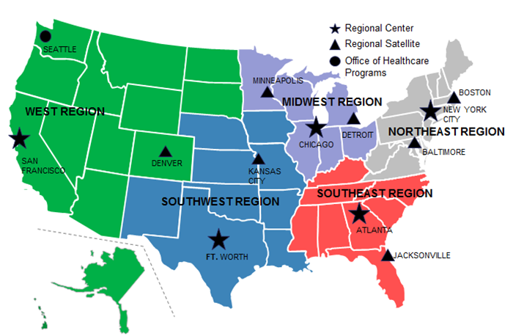
HUD Southeast Region

Slide 4
Southeast Region Leadership
(acting)
Southeast Regional Center Director
Cynthia Gordon-Benson
Operations Officer
Georgianna Baker-Gay
Program Analyst
LaDonna Mills
Director,
Production Division
Mark Dominick (acting)
Director, Atlanta
Asset Management Division 1
Mark Dominick
Director, Atlanta
Asset Management Division 2
Laurelei McKnight
Director, Jacksonville
Asset Management Division/Satellite
Edward Davis
Atlanta Underwriting
Branch Chief
Bonitta Smith
Account Executive
Branch Chief
James Moore
Account Executive
Branch Chief
Daphne Mallory
Jacksonville
Account Executive
Branch Chief
Ed Wallace
Atlanta Underwriting
Branch Chief
Yolanda Perez
Account Executive
Branch Chief
Mary Bolmgren
Account Executive
Branch Chief
Daniel Ortiz
Jacksonville
Account Executive
Branch Chief
Barbara Williams
Jacksonville Underwriting Branch Chief
Bhavna Patel
Account Executive
Branch Chief
Rudy Clemons
Account Executive Branch Chief
Belinda Koros
Jacksonville
Account Executive
Branch Chief
Lee Allen
Jacksonville Acting Underwriting Branch Chief
Alice Mobley
Asset Resolution Specialist Branch Chief
Sam Lytle
Account Executive
Branch Chief
Jon Bonner
Atlanta Technical Specialist
Branch Chief
Saadia Figueroa-Davis
Jacksonville
Asset Resolution Specialist Branch Chief
Mark Malec
Jacksonville Technical Specialist Branch Chief

Slide 5
Challenges (AM)
The Region is currently understaffed by more than 30 positions (across AM/Production).
Recent attrition in Greensboro, Knoxville, Nashville
Portfolios approaching average of 90 or more assets.
Disaster response from Hurricanes Irma, Maria, Florence and Michael

Slide 6
Opportunities (AM)
Fully staff the region by posting and hiring additional staff persons.
Recent job postings and more to come, backfilling in Atlanta and Jacksonville
Re-staff key positions such as Account Executives (AE) and SAE
Create National Hurricane Response and Recovery team.

Slide 7
Achievements (AM)
ATL: over 17,5000 items processed (92%)
28% replacement reserves, 98% timely
Most common: MARs, AFS
RAD conversions
Following risk based servicing model
Shift processing of special claims, consolidate
Funding/Service Coordinate Grants

Slide 8
Updates
4350.1 Handbook revisions
Changes to REAC Protocol
14-day notification period
RAD for PRACs
PBCA Extensions
202/811 NOFAs

Slide 9
2018 Southeast Region Loans Processed

Slide 10
Challenges
The Region is currently understaffed by more than 30 positions.
Finding a quick solution to minimizing environmental issues and processing time.

Slide 11
Opportunities
Fully staff the region by posting and hiring 26 additional staff persons.
Re-staffing in Atlanta and Jacksonville, external advertisements.
CPD will review and comment and Housing will make the final decision to approve or reject.
Create National Hurricane Response and Recovery team.

Slide 12
Southeast Region Apartment Markets 4th Quarter FY 2018 Vacancy Rates
Apartment markets in the Southeast region were generally balanced to slightly tight despite large pipelines in most areas, with the highest vacancy rates in Charleston and Columbia, at 6.4 and 6.0 percent, respectively.
The tightest major markets in the region were Knoxville and Orlando, with vacancy rates of 3.2 and 3.9 percent, respectively (RealPage, Inc.).
Vacancy rate trends were mixed across the region, but changes from a year earlier were typically small, at less than 1 percentage point.
The largest decline occurred in Birmingham, where the rate decreased 1.4 percentage points to reach 5.4 percent. Miami had the largest increase in the rate, at 0.4 percentage points, but the market remained slightly tight at 4.2 percent.

Slide 13
Southeast Region Apartment Markets 4th Quarter FY 2018 Units Under Construction
The number of units under construction remained elevated in most markets in the region. Atlanta continued to lead the region, as it had during the past 4 years, with more than 13,800 units under construction and was the only metropolitan area in the region with more than 10,000 units under construction.
Miami, Charlotte, and Orlando followed Atlanta in the number of units under construction, with approximately 9,000, 8,800, and 7,650 units, respectively.
Trends in construction varied widely across the region with the number of units under construction falling as much as 75 percent in West Palm Beach but increasing 80 percent in Miami, to 570 and 9,000 units, respectively.
The largest absolute decline in the number of units under construction occurred in Tampa where the number of units fell by approximately 1,900, or 31 percent, to approximately 4,350.

Slide 14
Southeast Region Apartment Markets 4th Quarter FY 2018 Annual Absorption
Annual absorption slowed in several metropolitan areas of the region compared with the same period a year earlier—including Greenville, Memphis, Miami, Nashville, Orlando, and West Palm Beach—with the largest decline of nearly 3,250 units in Orlando to 5,000 units.
Annual absorption fell by 1,100 and 1,200 units in Miami and Memphis to approximately 3,300 and 700 units, respectively.
Charlotte and Raleigh had the largest increases in annual absorption at approximately 1,200 units each, to reach approximately 7,450 and 5,500 units, respectively.

Slide 15
Southeast Region Apartment Markets 4th Quarter FY 2018 Rent Growth
Rent growth throughout the region was generally higher than typical for the respective areas. Unusually high annual rent growth of nearly 9 percent occurred in Birmingham followed by 7-percent increases in Greenville, Nashville, and Tampa.

Slide 16
Southeast Region Apartment Markets 4th Quarter FY 2018 Highest Rents
The highest rents in the region were in Florida markets; Miami, West Palm Beach, and Fort Lauderdale averaged approximately $1,610, $1,580, and $1,580, respectively, up from $1,520, $1,490, and $1,480 a year earlier.

Slide 17
RAD Context – Program Justification
1.1 million public housing units managed by 3,000+ local housing authorities (PHAs)
Major challenges:
In 2010, massive capital needs backlog of $26 billion, which has grown by $3.4 billion per year
Backlog of unmet capital needs likely to reach $70 billion by 2020.
Underfunding (by roughly $500 million annually, on average) of HUD’s Public Housing Operating Fund every year since 2011
Need: $4.6 billion and $5.1 billion, according to HUD’s own formulas
Notes:
PROGRAM CONTEXT & JUSTIFICATION:
The nation’s 1.1 million units of public housing is managed by about 3,000 local housing authorities
Public housing faces major challenges - by 2020, the massive backlog of unmet capital needs is likely to reach $70 billion.
HUD’s public housing operating fund should have received between $4.6 billion and $5.1 billion every year since 2011, according to HUD’s own formulas. Instead, year after year, the operating funds allocated by Congress have fallen short by an average of roughly half-a-billion dollars per year.
The shortage has been worse for capital funds, which public housing authorities use to prevent problems like leaky roofs and failing boilers. In 2010, there was a $26 billion backlog of capital needs in the public housing portfolio, according to HUD’s assessment conducted in that year. Since then, the backlog has grown by $3.4 billion per year, plus “the increased cost of deferred maintenance and judicious inflation, as provided in the 2010 assessment.
All have been under stress because of the lack of funding, though housing authorities on the Eastern and Southern U.S. are under particular strain because they have some of the oldest public housing buildings.
Where housing authorities are unable to make basic repairs, address environmental problems such as lead and mold, or address major system or roof replacements, apartments become uninhabitable – resulting in an estimated loss of about 10,000 units per year through (involuntary) demolitions and dispositions.

Slide 18
RAD In Concept - Program Authorization
Consolidated and Further Continuing Appropriations Act, 2012, (Pub. L. 112-55, signed November 18, 2011, as amended)
RAD Notice PIH-2012-32 (HA), as amended
350,000+ units already reserved, and program expected to reach its current statutory cap within the next one to two years.
FY20 Budget requests elimination of the statutory cap, allowing the conversion of any PH property that can do so on a cost-neutral basis.
Year | Units Authorized for Conversion
2012 | 60,000 (through 9/30/2015)
2014 | 185,000 (through 9/30/2015)
2015 | 240,000 (through 9/30/2018)
2018 | 455,000 (through 9/30/2024)

Slide 19
RAD in Practice - Program Components & Types
RAD for Public Housing also known as the “1st Component”
RAD for Other Multifamily Housing also known as the “2nd Component”
Public Housing
(455,000 unit cap*)
* Administration’s FY2020 budget requests elimination of the cap on public housing conversions.
Rental Assistance Payment
Sec. 8 Moderate Rehabilitation
Rent Supplement
PRAC for Sec. 202
McKinney Vento SRO
RAD
Conversion
Section 8 PBRA
Section 8 PBV
Notes:
PROGRAM COMPONENTS & TYPES:
Two Components - The Rental Assistance Demonstration Program (RAD) allows proven financing tools to be applied to at-risk public and assisted housing under two components:
1. RAD for PHAs – Allows Public Housing properties to convert, under a competition limited to 455,000 units, to long-term Section 8 rental assistance contracts.
RAD Component 1 (RAD for Public Housing)
RAD (Basic and Complex)
FHA-RAD
2. RAD for Multifamily – Allows Rent Supplement (Rent Supp), Rental Assistance Payment (RAP), Mod Rehab and Section 202 PRAC properties to convert tenant-based vouchers issued upon contract expiration or termination to project-based assistance.
RAD Component 2 (RAD for Other Multifamily Housing)
Section 8 Mod Rehab
Rental Assistance Payments
Rent Supplement
McKinney-Vento SRO
Section 202 PRAC Conversions* (Note: Pre-1974 202s and 202 Direct Loans with Section 8 are not eligible for RAD)

Slide 20
RAD in Practice - Compare & Contrast
Commonalities (FHA & RAD)
HUD Underwriting
HUD Closing Coordinator
HUD Loan Documents & Templates
Organizational Documents
Title & Survey Review
Legal Opinion(s)
Fair Housing and Civil Rights requirements
Secondary Financing subordination
Construction Docs, as applicable
Replacement Reserve obligations
Certifications & Assurances

Slide 21
RAD in Practice - Compare & Contrast (Cont’d)
Key Considerations | RAD | FHA
HUD Interests | Preserve and maintain affordable housing Stabilize long-term funding No threat to insurance fund No assumption/ownership risk | Support and preserve housing through development, finance and insurance opportunities Insurance fund risk Assumption/ownership risk
HUD Commitment & Special Conditions | RAD Conversion Commitment (RCC) to convert the subsidy on the units | FHA Commitment to insure the mortgage loans
Ownership/Control | PHA or non-profit ownership/control required 2530 clearance not required for PHAs | For-profit or non-profit ownership allowed 2530 clearance required for FHA Borrower and other principals

Slide 22
RAD in Practice - Compare & Contrast (Cont’d)
Key Considerations | RAD | FHA
Lien Priority | RAD Use Agreement has superior/first lien position | FHA Mortgage in first financial lien position
Title & Survey | Title report or update acceptable New Survey not required, if Title Policy is otherwise acceptable to HUD | New lender’s Title Policy with endorsements required ALTA Survey required Exact match of property Legal Descriptions
Closing Logistics | RAD review often takes longer, partly due to signing process HUD executes documents first and delivers to Escrow Agent HUD does not attend Closings | Except for the Firm Commitment, HUD executes or endorses documents last HUD conducts the Closings

Slide 23
RAD in Practice - Compare & Contrast (Cont’d)
FHA-RAD Distinctions
Must satisfy both the FHA and RAD program requirements (FHA standards lead)
Dual underwriting and closing coordination roles
RAD program requirements have primacy over conflicting (e.g., LIHTC) program requirements
RAD legal clearance and document signing precedes the FHA closing and document recordings

Slide 24
RAD Results – Program Milestones
RAD Converts 100K Units- In FY19 the RAD Program converted its 100,000th public housing unit.
Averaged $57,000 per unit in improvements, and leveraged $5.7+ billion for private construction investment
More accessible homes and common areas, and increased number of homes designed for residents with disabilities
Generated 108,000+ jobs, often employing low-income residents through Section 3 hiring initiatives
Notes:
PROGRAM MILESTONES:
RAD Converts 100K - In FY19 the RAD Program converted its 100,000th public housing unit.
Averaged $57,000 per unit in improvements, and leveraged $5.7+B for private construction investment
Made homes and common areas more accessible, increasing the number of homes designed for residents with disabilities
Generated 108,000+ jobs, often employing low-income residents through Section 3 hiring initiatives
Rent Supp Completion - The last properties with contracts under the 1960s-era Rent Supplement (Rent Supp) rental assistance program were preserved and converted to project-based Section 8 assistance under RAD Component III, preserving 13,670 affordable homes.

Slide 25
RAD Results - Examples
Juniper and 10th (Midtown Atlanta, GA)
Atlanta Housing
149-unit Elderly project
Added amenities:
Energy-efficient features
Covered patios
Fitness center
Business center

Slide 26
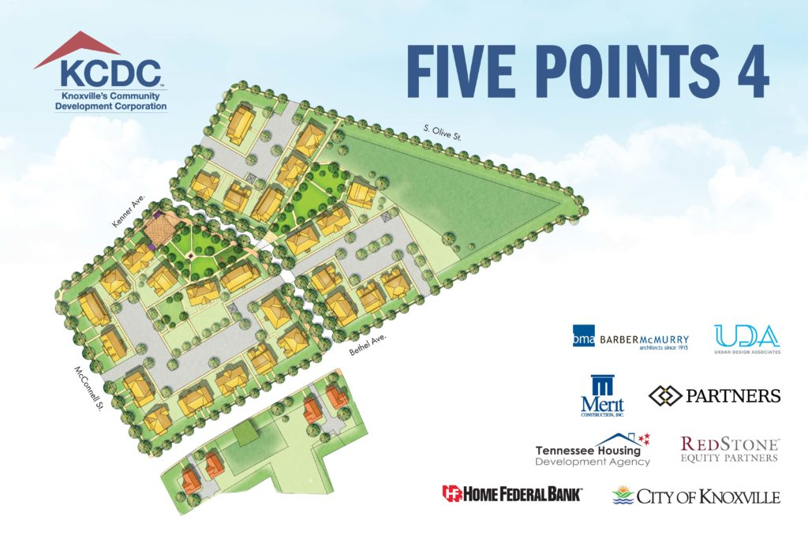
RAD Results - Examples
The Residences at Five Points (Knoxville, TN)
$85 million multi-phase project offering single-family homes, duplexes for seniors and multiplex buildings

Slide 27
RAD Results - Examples
Demolition of the Grove View (Fayetteville, NC), a PHA-owned property built in 1942 for military families.
Replaced by Cross Creek Pointe, a new RAD development that will provide 272-units of family housing on the same site.

Slide 28
RAD Trendlines
Addressing Post-Closing Issues – e.g.,
Refinancing or funding changes occur shortly after RAD conversion
Revisions needed to closing documents and title policies – e.g., DOT needing release found post-closing; incorrect legal descriptions or erroneous release from DOT; rooftop telecom leases on RAD Covered project;
Transfer of Assistance – e.g., ongoing management of scattered site property where DOT remained on property post-conversion due to pending sale
Tenant Lease Issues – Eviction without property notice and process
Failure to complete scope of work specified under RCC – e.g., failure to perform the work; failure to find Gap funding; failure to make required R4R deposits
Age preferences when post-conversion projects add preferences.
Notes:
Addressing Post-closing Issues - OGC recently issued internal protocols for increasingly more common scenarios, such as:
Refinancing or funding changes occur shortly after RAD conversion
Revisions needed to closing documents and title policies – e.g., DOT needing release found post-closing; incorrect legal descriptions or erroneous release from DOT; rooftop telecom leases on RAD Covered project;
Transfer of assistance issues – e.g., ongoing management of scattered site property where DOT remained on property post-conversion due to pending sale
Tenant Lease Issues – Eviction without property notice and process
Failure to complete scope of work specified under RCC – e.g., failure to perform the work; failure to find Gap funding; failure to make required R4R deposits
Age Preferences – How best to handle tenant selection and waiting lists when a converting family project incorporates a post-conversion age preference.

Slide 29
Thank you!

