Slide 1
HUD Conference: Emerging Strategies In Affordable Housing
Presented By:
Egbert L. J. Perry & Renee Glover
July 24, 2019

Slide 2
“The Atlanta Model”
Its Origin and Its Legacy
**Olympic Legacy Program
2003
Moving to Work
Other Atlanta Communities
National Commission on Severely Distressed Public Housing
*Centennial Place
1996 Interim Rules
Flex Rules
Choice Neighborhoods
HOPE VI Program
Other Mixed-Income Communities
LEGEND
* Centennial Place – 1st Mixed Use, Mixed Income Community in the nation
** Olympic Legacy Program – Includes East Lake, John Hope & John Eagan Homes
- - - Denotes HUD Initiatives

Slide 3
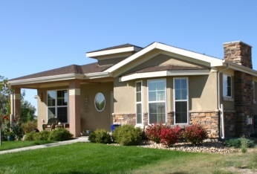
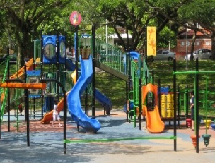
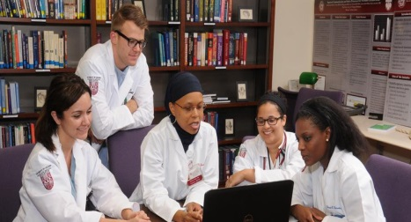
Quality of Life Circle / Community Development Infrastructure
Family & Community Services
Rental Housing
& Home Ownership
Jobs & Businesses
Retail & Commercial
Physical & Lifeline Infrastructure
People
(Families & Individuals)
Culture & Recreation
Early Childhood Development
Safety & Security
Education & Job Training

Slide 4
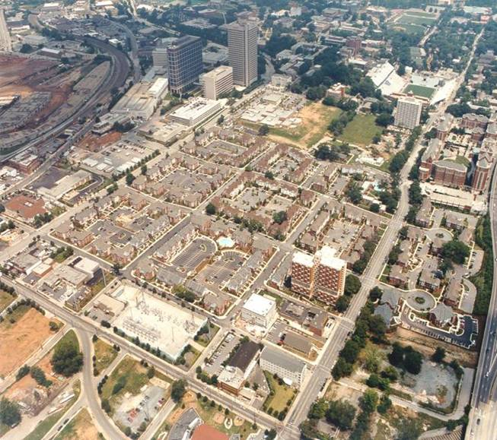
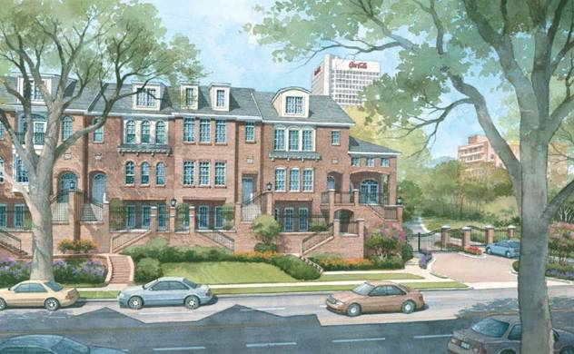
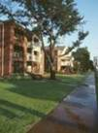
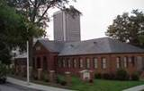
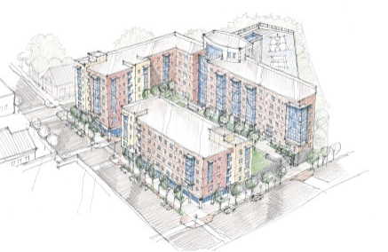
Centennial Place
Program Components
1 – Rental Units
2 – Branch Bank
3 – Elementary School
4 – YMCA
5 – Community Center
6 – Condominiums and Town Homes
7 – Sewer Upgrades
8 – Historic Building
9 – Lighting/Streetscapes
10 – Police Mini-Precinct
11 – Mixed-Use Center
4
3
2
6
5
1
7
1
8
9
1
10
11

Slide 5
Planning Phase For The Atlanta Model
P3 Revisits Human Development Component
(Re)occupancy Begins
First Completed Units Viewable
1996 SUMMER OLYMPIC GAMES
Centennial Place I Achieve Financial Closing
(Road Show Ends)
Demolition Commences
Relocation Begins
Media Begins “Love Affair” with the Model
Demolition Application is Filed
Communications Plan
Internal Team Communications
External Constituents
Media
Engage Local Financing Community
Engage Other Strategic Partners
Physical Master Plan Components
Mixed-Income Rental Housing
Mixed-Income For-Sale Housing
Retail
Commercial
SELLING THE CONCEPT AND THE VISION
Engage State & Local Partners
Quality of Life Infrastructure
Early Childhood Development Center
STEAM Elementary School
Connecting to #1 Middle & High Schools
Family YMCA
Parks & Recreation
Engage Federal Partners
Human Development Program
Family Coaching & Counseling Services
Job Training & Employment Placement
Youth Development Programs
Life Skills Training
Senior Programs
Begin The Road Show
Escalate Consultation with Residents
(9 hours per month, 18 months)
Establish 5 Strategic Program Goals
TIPA selected for PPP
RFP for Techwood/Clark Howell Homes
7/94 10/94 1/95 3/96 7/96 11/96 8/00

Slide 6
Implementation Phase For The Atlanta Model
Scholars Landing- Integral
Mechanicsville- Columbia/SUMMECH
Auburn Pointe- Integral/Urban Realty
Capitol Gateway – Integral/Trammell Crow/Urban Realty
West Highlands- Columbia/Brock Built
CollegeTown at West End - Integral
The Villages at Carver – Integral/Russell
Magnolia Park- Creative Choice Homes
LEGEND
The Villages at Castleberry Hill- Russell
Olympic
Legacy
Program
AHA as Development Program Manager
The Villages of East Lake- Cousins Foundation
Integral as Development Program Manager
Centennial Place- Integral/McCormack Baron
Integral/MBA as Developer & Development
Program Manager
1994 1995 1996 1997 1998 1999 2000 2001 2002 2003 2004 2005 2006 2007 2008
Year of Procurement

Slide 7
Examples of Human Development Success:
in The Atlanta Model
Element | Performance
Education | 48 Students from the inaugural class of Centennial Elementary School entered college in 2011, including many Ivy League/top tier Universities. Over 70% are graduates of high schools within the APS system. The Atlanta Community Scholars Fund, established in 2004 by AHA, has awarded 82 scholarships to students living in publicly funded housing.
Employment Growth & Stability | Of 2,805 families served from 4 Hope VI funded communities, 67% completed job training programs and 74% of employment referrals resulted in placement. At the end of 2009, 90% were employed.
Engagement in the larger Community | Client maintained a website for mothers battling HIV, based on her own experiences with the disease and her family. Seniors involved in Senior Idol Talent Competition and Healthy Lifestyles programs. Grandparents raising grandchildren involved in Project Healthy Grandparents and PTA’s Teens enrolling in Children’s Art Project, Youth Entrepreneurship, Debating, and Music Programs. Former AHA resident and mother of three sponsored by the NAACP as an exchange IT student to Germany.

