Slide 1
Tax Credit 101
4% and 9%
Emerging Strategies in Affordable Housing
Atlanta, GA
July 23, 2019
Holly Knight
202-699-1998
holly@bgcadvantage.com

Slide 2
Key Concepts
What is the Federal Tax Credit program and how does it enable the creation of Affordable Housing?
What are the benefits of developing affordable housing utilizing the Tax Credit Program (Section 42 of the IRS code)?
Why are entities looking to this program as a solution to revitalizing existing assets and expanding affordable housing within their portfolio?

Slide 3
What Are Tax Credits?
A way to get private money for affordable housing development
Created by Tax Reform Act of 1986
Section 42 of the IRS Code
Developer or non profit doesn’t have to pay it back
Impacts 30%-40% of multifamily construction

Slide 4
The Basics
The program originated in 1986 as a result of changes in the tax code under Ronald Reagan. The concept was to create a public private partnership for affordable housing development.
Congress was tasked with developing a program that incentivizes individuals to invest in real estate that was affordable to renters.
This program provides value in the form of a dollar for dollar tax credit for an investor in affordable housing. This “value” added by the federal government results in equity to the multifamily real estate transactions.

Slide 5
What Can It Be Used For?
Acquisition and Conversion of existing housing
New construction
Mixed use development
Different types of projects
Tax credit only projects
Mixed financed projects
Bond finance projects

Slide 6
How does the credit create affordable housing

Slide 7
Makes Housing More Affordable
WITHOUT TAX CREDITS
Op Expense = $500
Mortgage Pmt = $600
Rent = $1,100
WITH TAX CREDITS
Op Expense = $500
Mortgage Pmt = $250
Rent = $750

Slide 8
Incentives of Tax Credits
Benefits those who pay a lot of taxes
More attractive than tax deductions
Dollar-for-Dollar tax reduction in taxes
Investor gets tax credit and most of depreciation allowance

Slide 9
Benefits of LIHTC
Brings “free money” into the project
Allows PHA to build better developments
Allows PHA to build/rehab more units
Allows PHA to leverage money for more impact
Can be combined with other grants and loans and programs (i.e., Section 8)

Slide 10
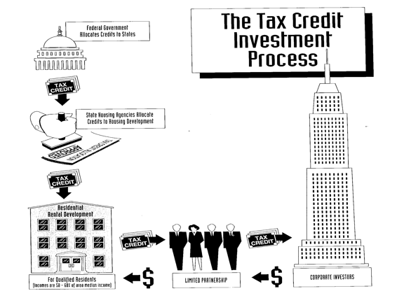
How do Tax Credits get to a Project?

Slide 11
How Do They Work?
Different rates for LIH Tax Credits
9% and 4%
Acquisition only qualifies for 4% tax credits
New Construction and Rehab may qualify for 9% tax credits

Slide 12
9% LIHTC
Competitive
Used with Conventional Financing
No federally-subsidized financing

Slide 13
4% LIHTC
Non-Competitive
Used with tax exempt Bond financing
May be used with federally subsidized financing

Slide 14
Who Issues Tax Credits
Federal Gov’t allocates to States
Annual Per Capita Authority (ACA) for 9%
TCs on 4% is limited by State’s Bond volume cap

Slide 15
Eligible Projects (20/40 Rule)
>20% Tenants <50% of median income
OR
>40% Tenants <60% of median income

Slide 16
Developer Sells Tax Credits
How much can be raised depends on:
Tax Laws and Tax Rates
Market
Economy
Was about $0.95 to the dollar
Now about $0.79 to $0.85 to the dollar
Maybe more if in a CRA $0.90 to $0.95

Slide 17
Incentive of Tax Credits 10-year credit period
New Construction Cost*
Eligible Basis – 100%
4% Annual Tax Credit
9% Annual Tax Credit
= $10,000,000
= $10,000,000
= $400,000 tax credit
$4,000,000 total TC
=$900,000 tax credit
$9,000,000 total TC

Slide 18
PHA Considerations
Ownership structure is different
Expertise is required (outside help)
Board training
Staff training
Application process is complex
Long
Competitive
Rules of project operation and monitoring apply

Slide 19
Ownership is Partnership
Developer (general or managing partner)
PHA’s nonprofit
Development Partner
Investors (limited partner)

Slide 20
Happy Town, LP
Investor, LP
99.99%
BGC Advantage, LLC
51%
Scottsdale Housing Development Corporation, LLC
49%
Happy Town, GP
.01%
SHA
100%

Slide 21
Expertise Required
Development
Procurement of Development Partner
Legal (general and bond)
Financial
Bond
Management
10 year benefit period
15 year compliance period

Slide 22
Predevelopment Stage
Allocation Plan/Application Process (QAP)
Project Receives Tax Credit Allocation
Sponsor Forms Limited Partnership
Asset Management Monitor s Project on Behalf of Investors
General Partner (0.1% owner)
Limited Partner (99.9% owner)
Development Construction and Permanent Financing
Property Management arranged
Project to managed for minimum of 15 years subject to tax credit income limits and rents (Compliance Period)
Investors exit LP in 16th year – required to pay exit taxes

Slide 23
Low Income Housing Tax Credits
How Can They Work For You?

